Slide 1
Chapter XII
Screen-space Object Manipulation

Slide 2
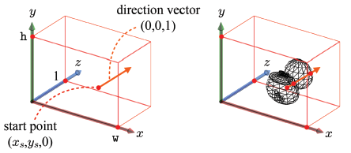
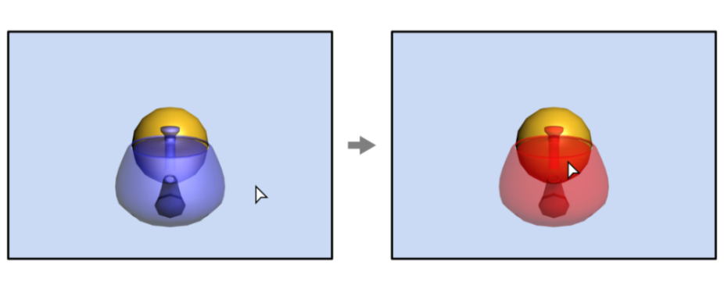
Object Picking
On touchscreen, an object can be picked by tapping it with a finger. In PC screen, mouse clicking is popularly used for the same purpose.
Mouse clicking simply returns the 2D pixel coordinates (x_{s},y_{s}). Given (x_{s},y_{s}), we can consider a ray described by the start point (x_{s},y_{s},0) and the direction vector (0,0,1).
We need ray-object intersection tests to find the object first hit by the ray, which is the teapot in the example. However, it is not good to compute the intersections in the screen space because the screen-space information available to us is about the pixels or fragments, not about the objects.
Our solution is to transform the screen-space ray back to the object spaces and do the intersection tests in the object spaces.
12-<number>

Slide 3
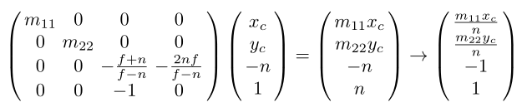
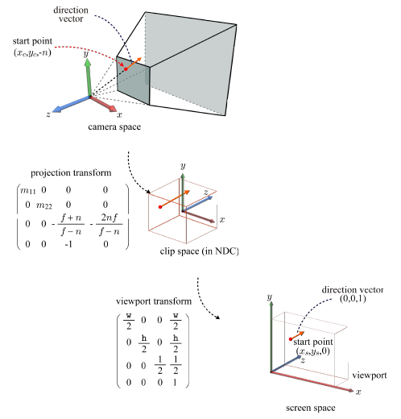





Camera-space Ray
direction vector of
the camera-space ray
12-<number>

Slide 4
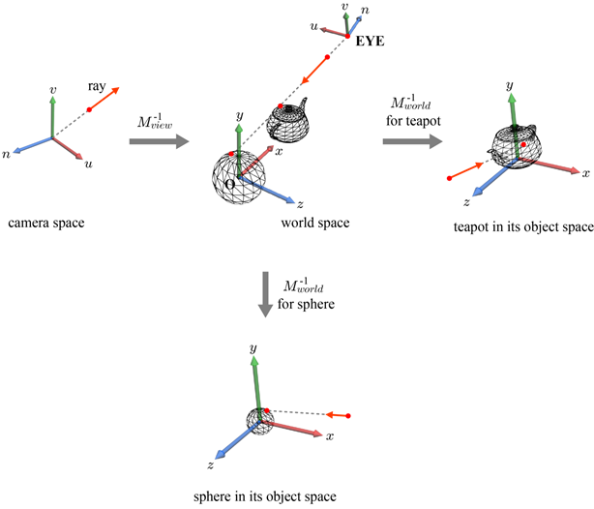
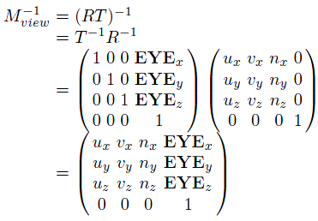
Object-space Ray
It is straightforward to transform the camera-space ray into the world space and then to the object space.
12-<number>

Slide 5
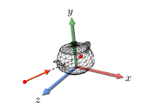
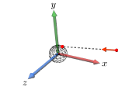
Ray Intersection
In order to determine if a ray hits an object represented in a polygon mesh, we have to perform a ray-triangle intersection test for every triangle of the object. If there exists at least a triangle intersecting the ray, the object is judged to be hit by the ray.
Unfortunately, processing every triangle would be costly. A faster but less accurate method is to approximate a polygon mesh with a bounding volume (BV).
12-<number>

Slide 6

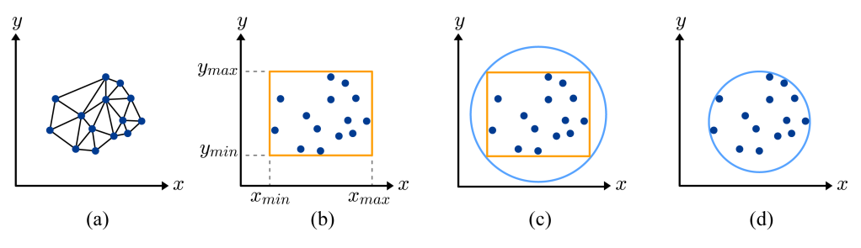
Bounding Volumes
Bounding volumes
Bounding volume creation
12-<number>

Slide 7
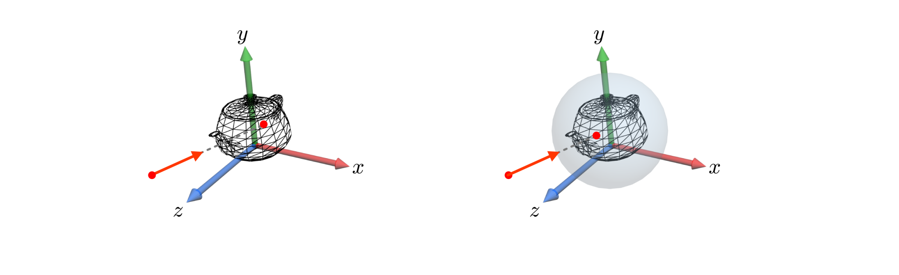
Ray Intersection (cont’d)
Intersection tests with polygon meshes vs. bounding volumes.
12-<number>

Slide 8


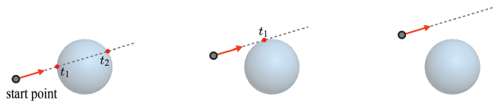
Ray Intersection (cont’d)
For the ray-sphere intersection test, let us represent the ray in a parametric representation.
Three cases determined by the discriminant.
Given two distinct roots, choose the smaller.
12-<number>

Slide 9
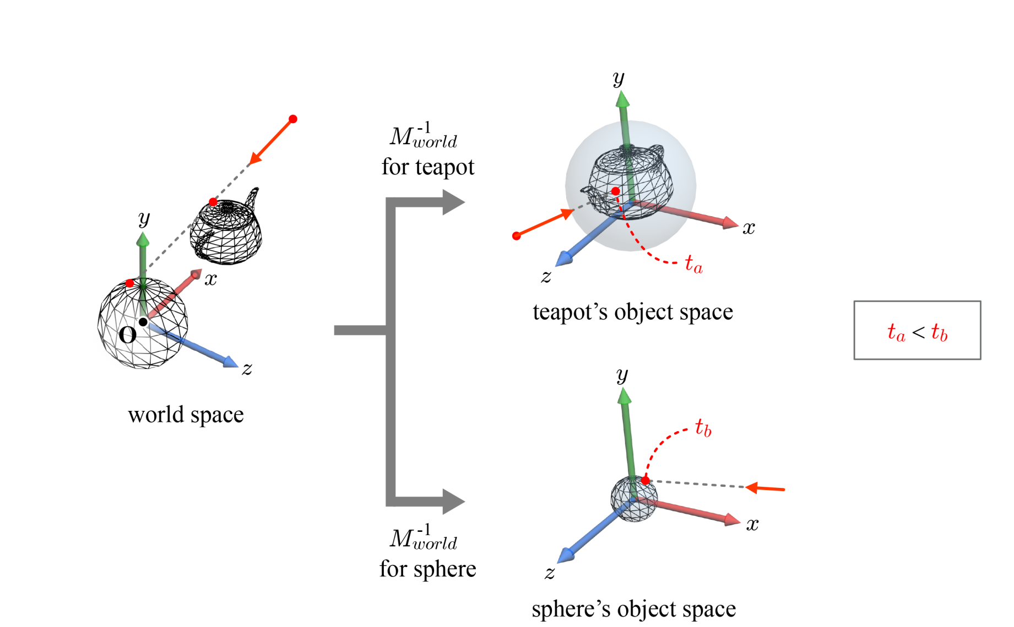
Ray Intersection (cont’d)
The bounding sphere hit first by the ray is the one with the smallest t.
12-<number>

Slide 10
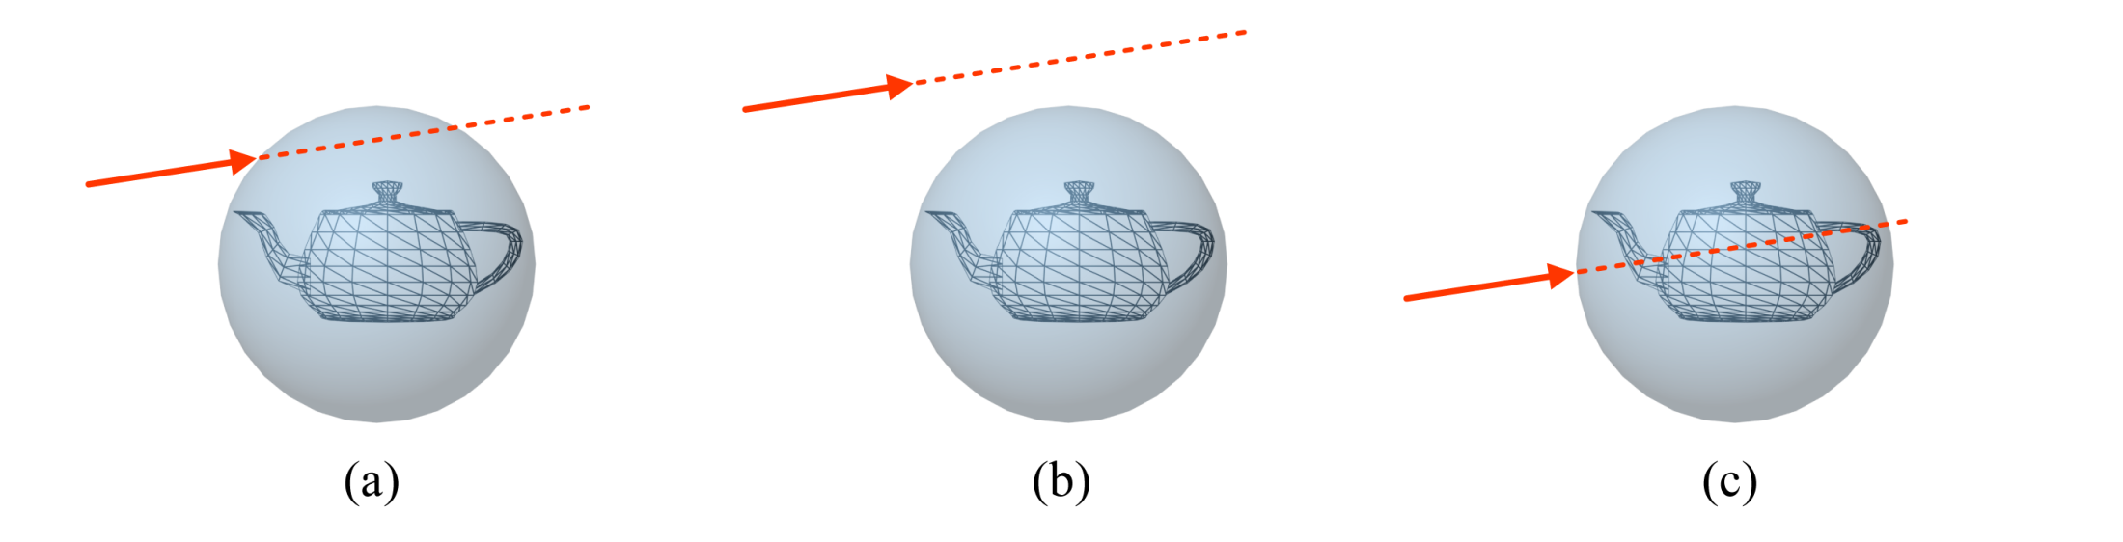
Ray Intersection (cont’d)
Ray-sphere intersection test is often performed at the preprocessing step, and discards the polygon mesh that is guaranteed not to intersect the ray.
12-<number>

Slide 11
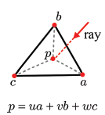

Ray Intersection (cont’d)
A point in a triangle
The weights (u,v,w) are called the barycentric coordinates of p.
The triangle is divided into three sub-triangles, and the weight given for a control point is proportional to the area of the sub-triangle “on the opposite side.”
Obviously, u+v+w=1, and therefore w can be replaced by (1-u-v), i.e., p=ua+vb+(1-u-v)c.
12-<number>

Slide 12
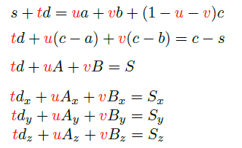
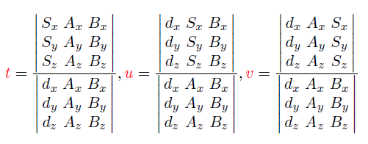
Ray Intersection (cont’d)
Computing the intersection between a ray, s + td, and a triangle, <a, b, c> is equivalent to solving the following equation:
The solution to this system is obtained using Cramer's rule:
The intersection point is computed by inserting t into the ray equation, s + td, or by inserting u and v into ua+vb+(1-u-v)c.
12-<number>

Slide 13
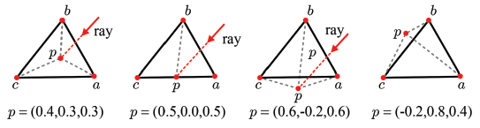

Ray Intersection (cont’d)
In order for the intersection point to be confined to the triangle, the following condition should be satisfied: u ≥ 0, v ≥ 0, and u+v ≤ 1.
When every triangle of a mesh is tested for intersection with the ray, multiple intersections can be found. Then, we choose the point with the smallest positive t.
12-<number>

Slide 14
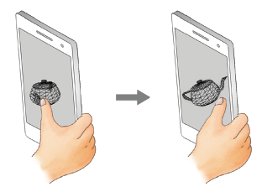
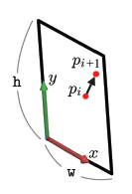
Object Rotating
Rotating an object is used as frequently as picking an object.
On the 2D screen, the sliding finger's positions, {p₁, p₂, … , p_{n}}, are tracked. For each pair of successive finger positions, p_{i} and p_{i+1}, a 3D rotation is computed and applied to the object.
12-<number>

Slide 15
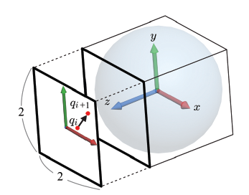

Arcball
The arcball is a virtual ball located behind the screen and encloses the object to rotate. The sliding finger rotates the arcball and the same rotation applies to the object.
For efficient implementation, the 2D screen with dimensions w×h is normalized to the 2×2 square, and the 2D coordinates, (x,y), of the finger's position are accordingly normalized, i.e. p_{i} and p_{i+1} are converted to q_{i} and q_{i+1}.
12-<number>

Slide 16

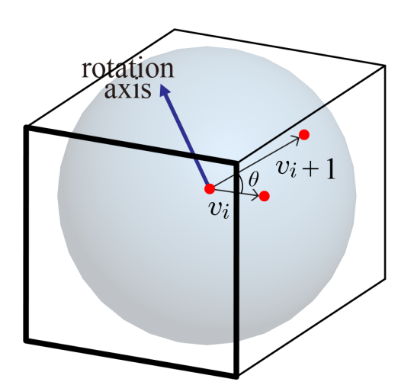
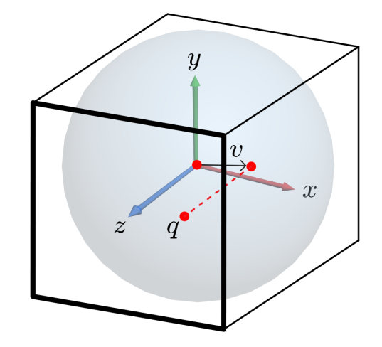
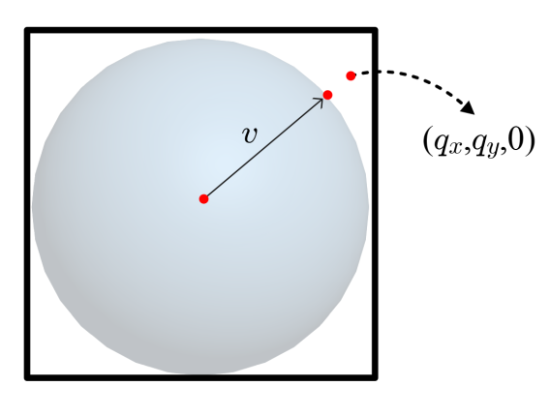

Arcball (cont’d)
Then, q is orthographically projected along –z onto the surface of the arcball. Let v denote the vector connecting the arcball’s center and the projected point.
Note that v_{x}=q_{x}, v_{y}=q_{y}, and v_{z}= .
If the projection is out of the arcball, v=normalize(q_{x},q_{y},0).
Given v_{i} and v_{i+1}, we can compute the rotation axis and angle.
  The rotation axis is obtained by taking the cross product of v_{i} and v_{i+1}.
  The rotation angle is obtained from the dot product of v_{i} and v_{i+1}.
12-<number>

Slide 17
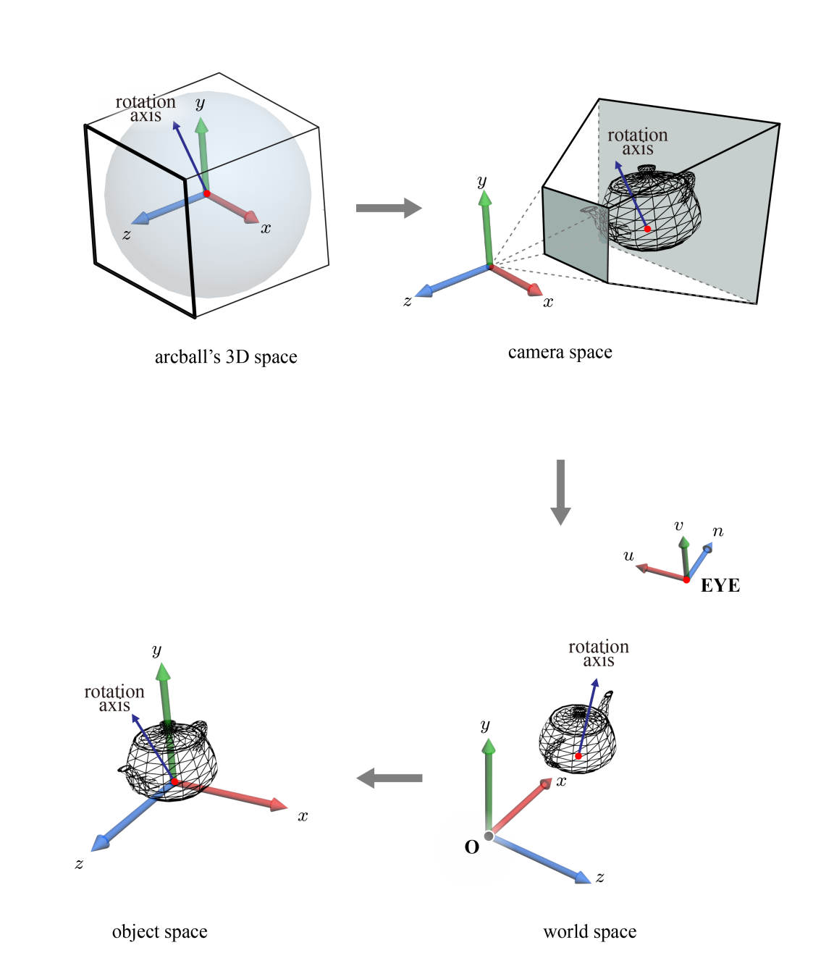
Object-space Rotation Axis
The rotation axis should be redefined in the object space so that the rotation is made prior to the original world transform.
We computed the rotation axis in the arcball's space. It is a temporarily devised coordinate system, which we have not encountered in the rendering pipeline.
Our strategy is then to take the rotation axis as is into the camera space of the rendering pipeline.
The rotation axis, as a vector, can be thought of as passing through the object in the camera space, and such a configuration is preserved in the object space.
12-<number>

